Slide 1

Multiple Linear Regression (Case Study -1)
Submitted By: ARNAB DEY
UID:18BCS6951

Slide 2
Question:
DESCRIPTION: Predict cancer mortality rates for US counties.
YOUR TASK: Build a multivariate Ordinary Least Squares regression model to predict "TARGET_deathRate"

Slide 3
Process followed
Reading the csv file
Understanding the data
Variable Identification
Missing value treatment
Data Visualisation
Dividing data into training and testing dataset
Scaling Features
Feature selection
Building a model

Slide 4
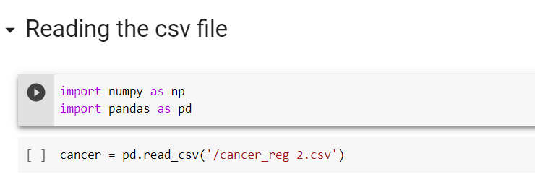
Reading the data
We use read_csv function to read data files.

Slide 5
Variable identification
There are two types of variable ,Dependent and Independent variable.
TARGET_deathRate is our Dependent variable as we are building a model to predict the deathrate from our dataset.
Columns other than TARGET_deathRate can be use to build the prediction model, those are Independent variable.

Slide 6
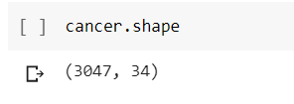
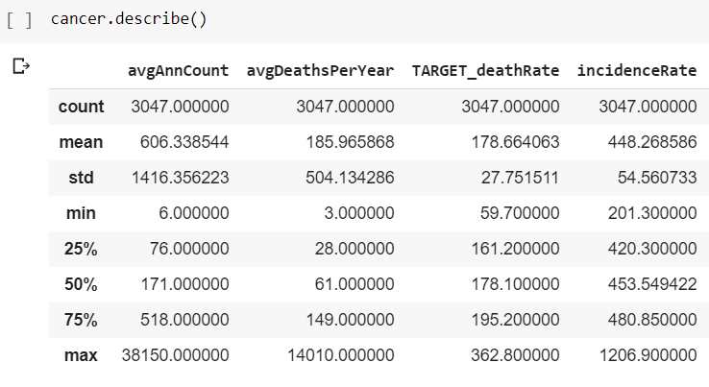
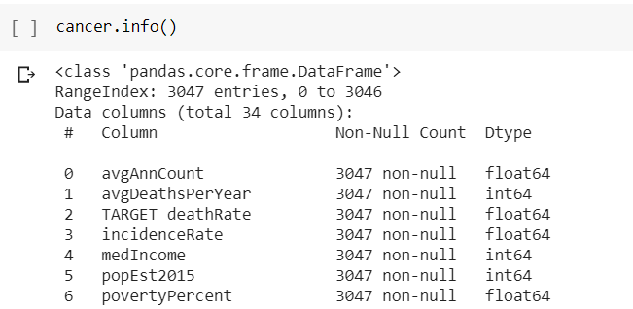
Understanding the data
df.shape() – give idea about rows and columns
df.describe() – shows count, mean,std,25%,75%,50%,min,max values of every columns.
df.info()- shows non-null ,dtypes of the columns.

Slide 7
Missing value treatement
Df.isnull().sum() – it gives the total null values in a dataset
Null values create problem while building the model , so null value treatment is important if we use those columns in our model prediction.
By treating missing values we can build a better model.

Slide 8
Data visualisation
Data visualisation is done by Univariate analysis and Bivariate Analysis
Univariate analysis tells us about the outliers in our data set.
It can be done using box plot
Bivariate analysis tells us the relation between the columns.
It can be done using scatterplot.

Slide 9
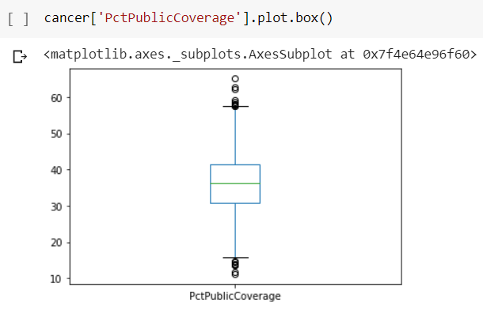
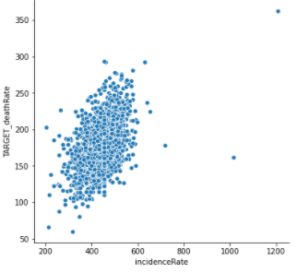
Continues….
Box Plot:
Scatter Plot:

Slide 10

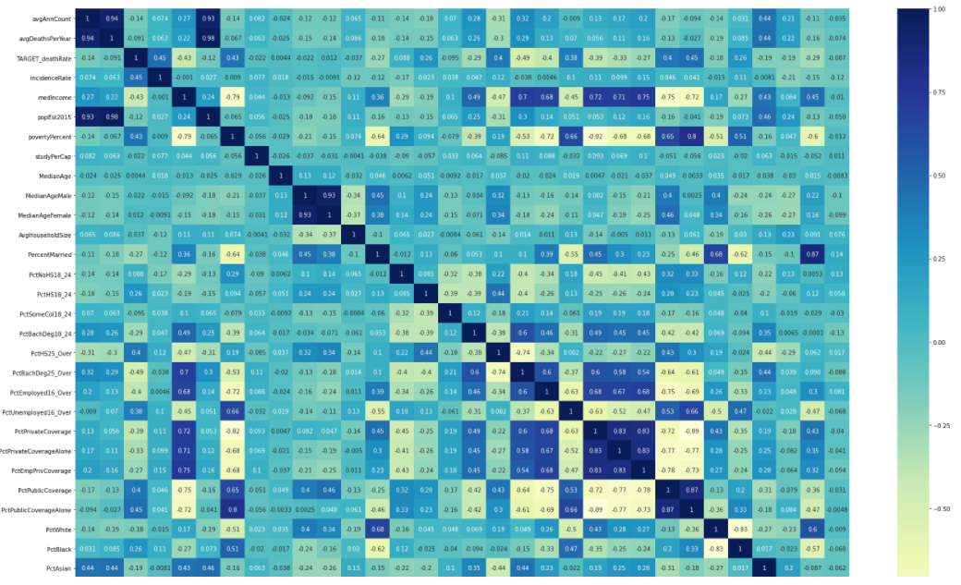
Continues…..
We create heatmap to understand the correlation between our targer variable and independent variable.
We can use the high corelated value columns to build our model but we also have to see VIF, p-values.

Slide 11
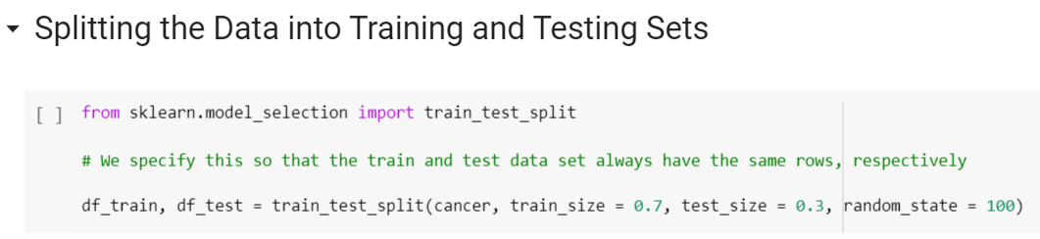
Dividing data into training and testing dataset
We have divided our dataset into training and testing data frames.
Here we have divided our dataset into 70% and 30% of the data.

Slide 12
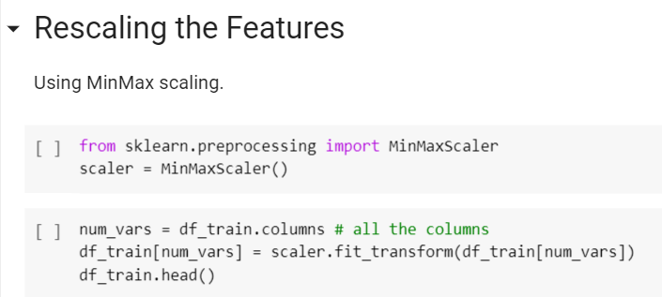
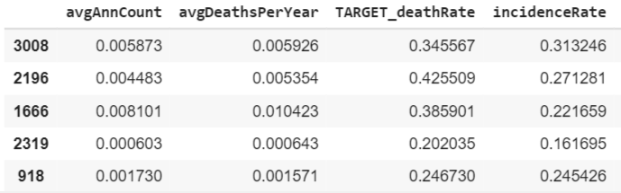
Scaling feature
Here we have scaled our columns by using min-max scaling.
By scaling all the values come between 0 to 1.
Scaling does not effect correlation, p-values, VIF or anything.

Slide 13
Feature selection
Here we have use RFE model to select the features for independent variable.
At first I have found 10 columns from 32 columns and fit the regression model according to it. After building the model I get r2 = 0.489.
In summary we found ‘popEst2015’ and ‘PercentMarried’ column have p-values greater than 0.05 so, we have decided to drop the columns.
After dropping the columns we again build the model fit the curve but now the r2 comes out to be 0.488.

Slide 14
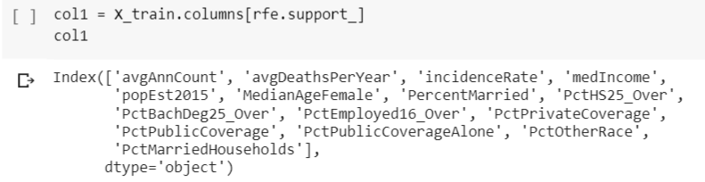
Continues….
After that to improve the model and get a better r2 value we take 15 independent variable instead to 10, by using RFE model feature selection.
rfe.support gives us the 15 columns that can be use in our training the model to get the best result for our model building.

Slide 15
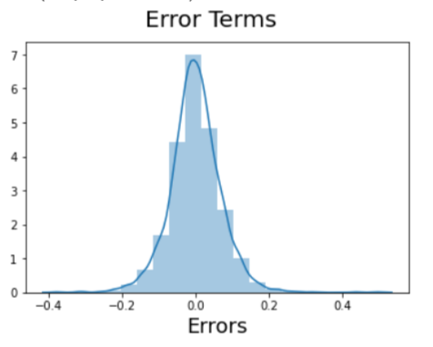
Continues….
After using 15 columns in building our model ,we get r2 value as 0.506
And all columns contains p-value less than 0,05.
After that we plot a histogram to check if the error terms are also normally distributed ( it’s a major assumption of linear regression)
As we can see from the plot that our error terms are
normally distributed.

Slide 16
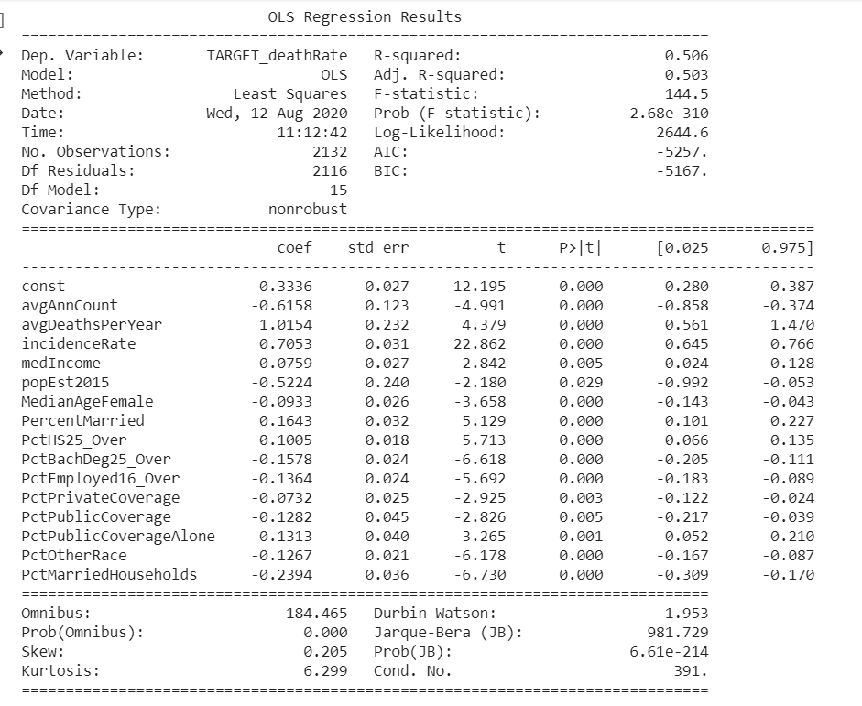
Result

Slide 17
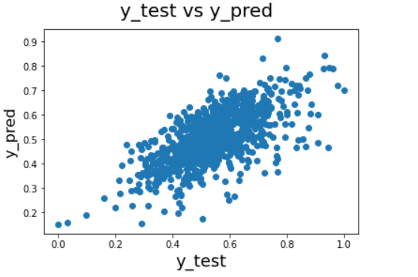
Model Evaluation
After training the model we implement in test data set,
And ‘y_pred’ is our predicted model.
From the graph we can find the Linear relation .

Slide 18
THANK YOU……

